Slide 1
Continuous Integration /Continuous Delivery on AWS

Slide 2
Codesuite Developer Tools
CodeCommit is their managed Git service. Useful if you want to keep your entire SDLC (Software Development LifeCycle) infrastructure in one AWS account.
CodeBuild is AWS CI tool / managed build service
CodeDeploy is AWS deployment automation tool — EC2 services
CodePipeline is AWS deployment pipeline service.
CloudFormation - AWS Infrastructure-as-Code (IaC) tool + service

Slide 3
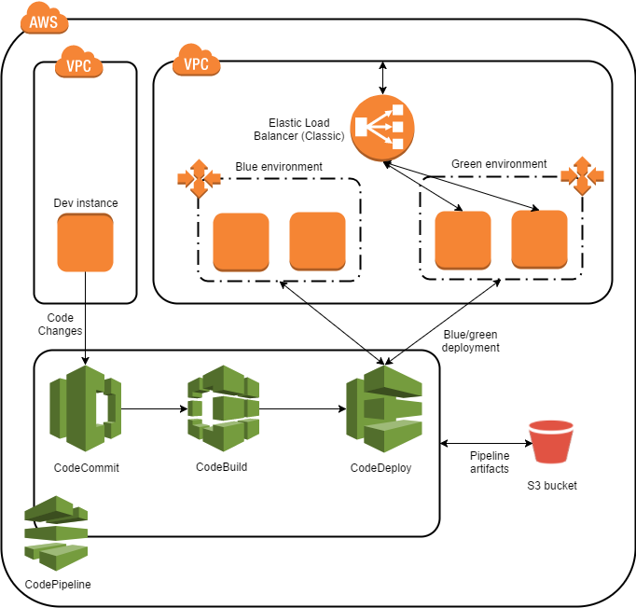
Use Case

Slide 4
CodeCommit
AWS CodeCommit is a fully-managed source control service that hosts secure Git-based repositories.
It makes it easy for teams to collaborate on code in a secure and highly scalable ecosystem.
CodeCommit eliminates the need to operate your own source control system or worry about scaling its infrastructure.
Use CodeCommit to securely store anything from source code to binaries, and it works seamlessly with your existing Git tools.

Slide 5
Benefits
Fully Managed
Secure
High Availability
Collaboration on code
Access Control
Faster –Repositories within AWS
Integrate with existing tools like Git

Slide 6
CodeBuild
Fully managed continuous integration service that compiles source code, runs tests, and produces software packages that are ready to deploy.
No need to provision, manage, and scale your own build servers.
CodeBuild scales continuously and processes multiple builds concurrently, so your builds are not left waiting in a queue
Get started quickly by using prepackaged build environments, or you can create custom build environments that use your own build tools.
With CodeBuild, you are charged by the minute for the compute resources you use.

Slide 7
Benefits
Fully Managed
Continuous Scaling
Pay as you go
Extensible
Enables CI/CD
Secure

Slide 8
Code Deploy
Fully managed deployment service that automates software deployments to a variety of compute services such as Amazon EC2, AWS Fargate, AWS Lambda, and your on-premises servers.
CodeDeploy makes it easier for you to rapidly release new features
Helps tou avoid downtime during application deployment, and handles the complexity of updating your applications.
Use AWS CodeDeploy to automate software deployments, eliminating the need for error-prone manual operations.

Slide 9
Benefits
Automated Deployments
Minimize Downtime
Centralized Control
Easy to use

Slide 10
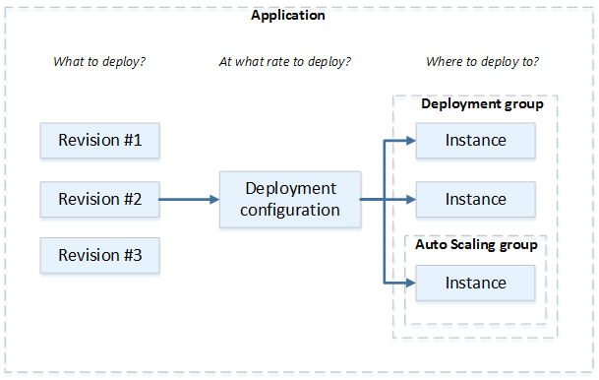
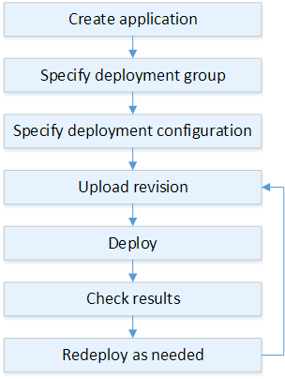
Deployment Components and Workflow on an EC2 Compute Platform
Ref:https://docs.aws.amazon.com/codedeploy/latest/userguide/deployment-steps-server.html

Slide 11
Code Pipeline
AWS CodePipeline is a fully managed continuous delivery service that helps you automate your release pipelines for fast and reliable application and infrastructure updates.
Automates the build, test, and deploy phases of your release process every time there is a code change, based on the release model
Enables to rapidly and reliably deliver features and updates.
Easy to integrate AWS CodePipeline with third-party services uch as GitHub or with your own custom plugin.
Pay for what you use. There are no upfront fees or long-term commitments.

Slide 12
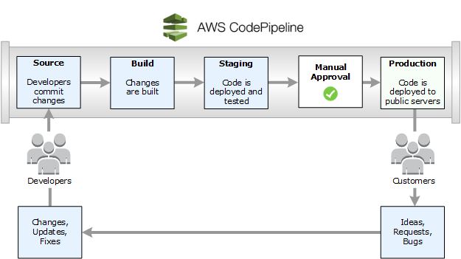
Release Process using CodePipeline

Slide 13
THANK YOU

